Slide 1
Deadlocks

Slide 2
Content
The Deadlock Problem
System Model
Deadlock Characterization
Methods for Handling Deadlocks
Deadlock Prevention
Deadlock Avoidance
Deadlock Detection
Recovery from Deadlock

Slide 3
Traffic only in one direction.
Each section of a bridge can be viewed as a resource.
If a deadlock occurs, it can be resolved if one car backs up (preempt resources and rollback).
Several cars may have to be backed up if a deadlock occurs.
Starvation is possible.
Note – Most OSes do not prevent or deal with deadlocks

Slide 4
BACKGROUND
The cause of deadlocks: Each process needing what another process has. This results from sharing resources such as memory, devices, links.
Under normal operation, a resource allocations proceed like this::
Request a resource (suspend until available if necessary ).
Use the resource.
Release the resource.

Slide 5
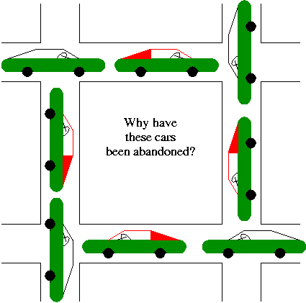
Deadlock

Slide 6
Definition
In a multiprogramming system, processes request resources. If those resources are being used by other processes then the process enters a waiting state. However, if other processes are also in a waiting state, we have deadlock.
Definition: A set of processes is in a deadlock state if every process in the set is waiting for an event (release) that can only be caused by some other process in the same set

Slide 7
Example 5.1
Process-1 requests the printer, gets it
Process-2 requests the tape unit, gets it Process-1 and
Process-1 requests the tape unit, waits Process-2 are
Process-2 requests the printer, waits deadlocked!

Slide 8
Deadlock is a situation where two or more processes are each waiting for a resource that another process in the group holds.
A process in a multi-programming system is said to be in a state of deadlock ( or deadlocked ) if it is waiting for a particular event that will not occur.
In multi-programmed computing system, resource sharing is one of the primary goals of the O.S.
When resources are shared among a population of users, each of whom maintains exclusive control over particular resources allocated to that user, it is possible for deadlocks to develop in which the processes of some users will never be able to finish

Slide 9
The Deadlock Problem
A set of blocked processes each holding a resource and waiting to acquire a resource held by another process in the set
Example
System has 2 disk drives
P₁ and P₂ each hold one disk drive and each needs another one

Slide 10
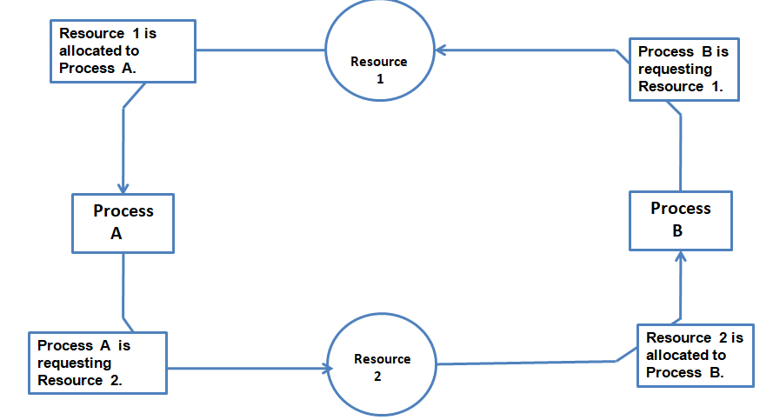
A Simple Resource Deadlock

Slide 11
System Model
A process must request a resource before using it, and must be release the resource after using it. A process may request as many resource as it requires may not exceed the total number of resources available in the system. Also, a process cannot request three printers if the system only has two.
Under the normal mode of operation, a process may utilize resources in only the following sequence:-
Request:- If the request cannot be granted immediately then the requesting process must wait until it can acquire the resources.
Use:- The process can operate on the resource ( if the resource is printer, the process can print on the printer).
Release:- The process releases all the resource allocated to that particular.

Slide 12
A system consists of a finite number of resources to be distributed among a number of competing processes.
The resources are partitioned into several types, each consisting of some number of identical instances
Memory space, CPU cycles, files, and I/O devices (such as printers and DVD drives) are examples of resource types.
If a system has two CPUs, then the resource type CPU has two instances. Similarly, the resource type printer may have five instances.
If a process requests an instance of a resource type, the allocation of any instance of the type will satisfy the request.

Slide 13
Resource types R1, R2, . . ., Rm
CPU cycles, memory space, I/O devices
Each resource type Ri has Wi instances.
Each process utilizes a resource as follows:
request
use
release

Slide 14
Deadlock Characterization
Before we discuss the various methods for dealing with the deadlock problem, we look more closely at features that characterize deadlocks.
Mutual exclusion condition
Hold and wait
No preemption condition
Circular wait condition

Slide 15
1. Mutual exclusion. At least one resource must be held in a nonsharable
mode; that is, only one process at a time can use the resource. If another
process requests that resource, the requesting process must be delayed
until the resource has been released.
2. Hold and wait. A process must be holding at least one resource and
waiting to acquire additional resources that are currently being held by
other processes.

Slide 16
3. No preemption. Resources cannot be preempted; that is, a resource can
be released only voluntarily by the process holding it, after that process
has completed its task.
4. Circular wait. A set {P0, P1, ..., Pn} of waiting processes must exist such that P0 is waiting for a resource held by P1, P1 is waiting for a resource held by P2, ..., Pn−1 is waiting for a resource held by Pn, and Pn is waiting for a resource held by P0.
We emphasize that all four conditions must hold for a deadlock to occur. The circular-wait condition implies the hold-and-wait condition, so the four conditions are not completely independent.

Slide 17
Resource Allocation Graph
Deadlocks can be described more precisely in terms of a directed graph called a system resource-allocation graph.
This graph consists of a set of vertices V and a set of edges E.
The set of vertices V is partitioned into two different types of nodes:
P ={P1, P2, ..., Pn}, the set consisting of all the active processes in the system, and
R ={R1, R2, ..., Rm}, the set consisting of all resource types in the system

Slide 18
A directed edge from process Pi to resource type Rj is denoted by
request edge – directed edge P_{i} → R_{j}
It signifies that process Pi requested an instance of resource type Rj and is currently waiting for that resource.
A directed edge from resource type Rj to process Pi is denoted by
assignment edge – directed edge R_{j} → P_{i}
It signifies that an instance of resource type Rj has been allocated to process Pi.

Slide 19
Process
Resource Type with 4 instances
P_{i} requests instance of R_{j}
P_{i} is holding an instance of R_{j}
P_{i}
P_{i}

Slide 20
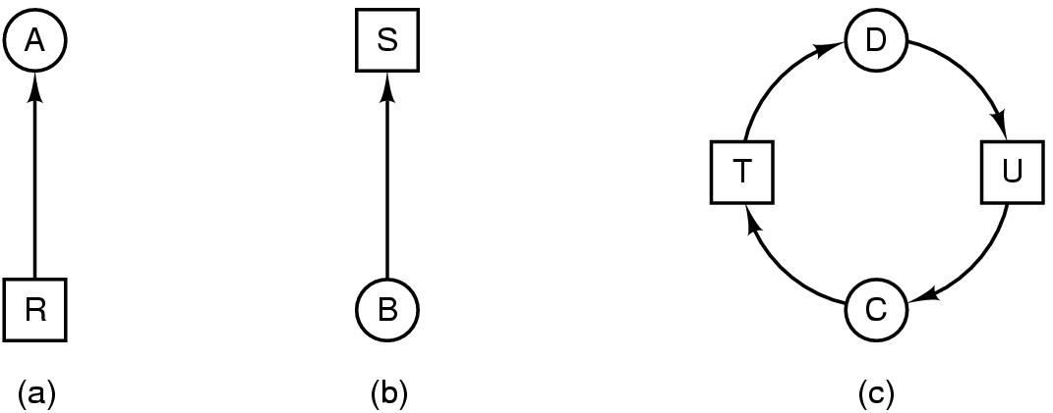
Simple RAG
resource R assigned to process A
process B is requesting/waiting for resource S
process C and D are in deadlock over resources T and U

Slide 21
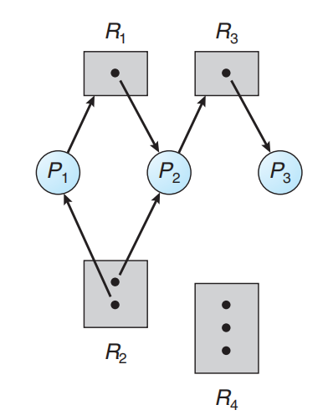
The sets P, R, and E:
◦ P = {P1, P2, P3}
◦ R = {R1, R2, R3, R4}
◦ E = {P1 → R1, P2 → R3, R1 → P2, R2 → P2, R2 → P1, R3 → P3}
• Resource instances:
◦ One instance of resource type R1
◦ Two instances of resource type R2
◦ One instance of resource type R3
◦ Three instances of resource type R4

Slide 22
Process states:
◦ Process P1 is holding an instance of resource type R2 and is waiting for an instance of resource type R1.
◦ Process P2 is holding an instance of R1 and an instance of R2 and is waiting for an instance of R3.
◦ Process P3 is holding an instance of R3.

Slide 23
Given the definition of a resource-allocation graph, it can be shown that, if the graph contains no cycles, then no process in the system is deadlocked.
If the graph does contain a cycle, then a deadlock may exist
If there is a cycle, and the cycle involves only resources which have a single instance, then a deadlock has occurred
If each resource type has several instances, then a cycle does not necessarily imply that a deadlock has occurred.

Slide 24

To illustrate this concept, we return to the resource-allocation graph
depicted in Figure. Suppose that process P3 requests an instance of resource type R2.
Since no resource instance is currently available, a request edge P3 → R2 is added to the graph Figure. At this point, two minimal cycles exist in the system:

Slide 25
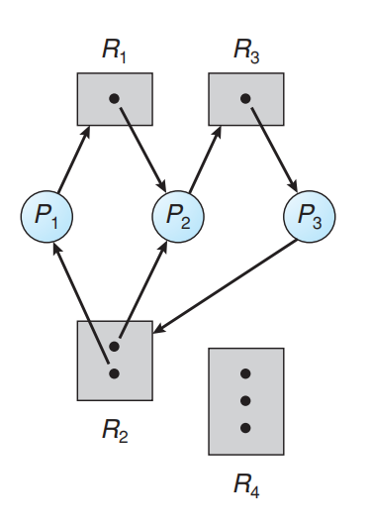
Processes P1, P2, and P3 are deadlocked. Process P2 is waiting for the resource R3, which is held by process P3. Process P3 is waiting for either process P1 or process P2 to release resource R2.
In addition, process P1 is waiting for proces P2 to release resource R1.

Slide 26
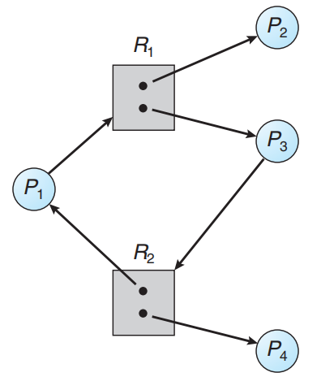

Now consider the resource-allocation graph in Figure
However, there is no deadlock. Observe that process P4 may release its instance
of resource type R2. That resource can then be allocated to P3, breaking the cycle

Slide 27
If graph contains no cycles ⇒ no deadlock
If graph contains a cycle ⇒
if only one instance per resource type, then deadlock
if several instances per resource type, possibility of deadlock

Slide 28
Methods for Handling Deadlocks
Generally speaking, we can deal with the deadlock problem in one of three ways:
• We can use a protocol to prevent or avoid deadlocks, ensuring that the system will never enter a deadlocked state.
• We can allow the system to enter a deadlocked state, detect it, and recover.
• We can ignore the problem altogether and pretend that deadlocks never occur in the system. used by most operating systems, including UNIX

Slide 29
Methods for Handling Deadlocks:-
There are diff. methods dealing with deadlock problems:
1.Deadlock Prevention: Disallow one of the four necessary conditions for deadlock.
2. Deadlock Avoidance:- Do not grant a resource request in this allocation have the potential to lead to a deadlock.
3. Deadlock Detection:- Always grant resource request when possible.
Periodically check for deadlocks. If a deadlocks exists, recover from it.

Slide 30
DEADLOCK PREVENTION
The various methods of deadlock prevention are considered, and the effects on both users and systems, especially from the standpoint of performance, are examined.
if any of the four necessary conditions is denied, a deadlock cannot occur.

Slide 31
Mutual Exclusion
To eliminate this mutual exclusion . allow everybody to use the resource immediately if they want to.
The mutual exclusion condition must hold for non-sharable resources.
Several processes cannot concurrently share a printer. Then, why mutual exclusion for this type. Sharable resources do not require mutual exclusion access & thus cannot be involved in a deadlock.
Read-only files are good examples of a sharable resource. If several processes attempt to open a read-only file @ the same time, they can be granted concurrent access to the file. A process never needs to wait for a sharable resource.
some resources are intrinsically non-sharable

Slide 32
Hold and Wait:-
To prevent, hold and wait, ensure that when a process requests resources, does not hold any resources.
One protocol that can be used requires each process to request and be allocated all its resources before it begins execution.
An alternative protocol allows a process to request resources only when the process has none.
A process may request some resources and use them, before it requests any additional resources, it must release all the resources that it is currently allocated.

Slide 33
There are two main disadvantages to these protocols:-
1. Resource Utilization may be low, since many of the resources may be
allocated but unused for a long period.
2. Starvation is Possible. A process needs several popular resources may
have to wait immediately. Because @least one of the resources that it
needs is always allocated to some other process.

Slide 34
No-Preemption:-
To ensure that this condition does not hold, the following protocol is used.
If a process that is holding some resources requests another that cannot be immediately allocated to it( i.e... Process must wait..).
Then all resources currently being held are pre-empted (i.e... Resources are implicitly released).
The pre-empted resources are added to the list of resources for which the process is waiting.
The process will be restarted only when it regains its old resources, as well as the new requested resources.

Slide 35
If a process requests some resources, first check whether they are available. If they are not available, we check whether they are allocated to some other process that is waiting for additional resources. If so, we pre-empt the desired resources from the waiting process and allocate them to the requesting process.
If the resources are not either available or held by a waiting process must wait. While waiting, some of its resources may be pre-empted, but only if another process requests them.
This protocol is often applied to resources whose state can be easily saved and restored later, such as CPU registers and memory space. It cannot generally be applied to such resources as printers and tape drivers.

Slide 36
Circular Wait:-
To ensure that this condition never holds is to impose a total ordering of all resource types, and to require that each process requests resources in an increasing order of enumeration.
Let R={R₁,R₂,……R_{m}} be the set of resource types.
We assign to each resource type a unique integer number, which allows us to compare two resources and to determine whether one precedes another in our ordering.
Each process can request resources only in an increasing order of enumeration. A process can initially request any number of instances of a resource type (say R_{i}).
The process can request instance of resource type R_{j}, if F(R_{j}) > F(Ri).
We can require that, whenever a process requests an instance of resource type R_{j}, it has released any resources Ri such that F(Ri) → F(R_{j}).

Slide 37
Deadlock Avoidance
The O.S. may delay granting a resource request, even when the resource are available, because doing so will put the system in an unsafe state where deadlock may occur later.
The basic idea of deadlock avoidance is to grant only those requests for available resources that cannot possibly result in a state of deadlock.
In order to evaluate the safety of the individual system states, deadlock avoidance requires all processes to state their max. resource requirements prior to execution.
Once its execution begins, each process requests its resources as and when needed, up to the max. proclaimed limit.
Processes, whose stated resource requirements exceed the total capacity of the system are not admitted for execution.

Slide 38
Requires that the system has some additional a priori information available
Simplest and most useful model requires that each process declare the maximum number of resources of each type that it may need
The deadlock-avoidance algorithm dynamically examines the resource-allocation state to ensure that there can never be a circular-wait condition
Resource-allocation state is defined by the number of available and allocated resources, and the maximum demands of the processes

Slide 39
Safe State
When a process requests an available resource, system must decide if immediate allocation leaves the system in a safe state
System is in safe state if there exists a sequence <P₁, P₂, …, P_{n}> of ALL the processes in the systems such that for each P_{i}, the resources that P_{i} can still request can be satisfied by currently available resources + resources held by all the P_{j}, with j < I
That is:
If Pi resource needs are not immediately available, then Pi can wait until all Pj have finished
When Pj is finished, Pi can obtain needed resources, execute, return allocated resources, and terminate
When Pi terminates, Pi +1 can obtain its needed resources, and so on

Slide 40
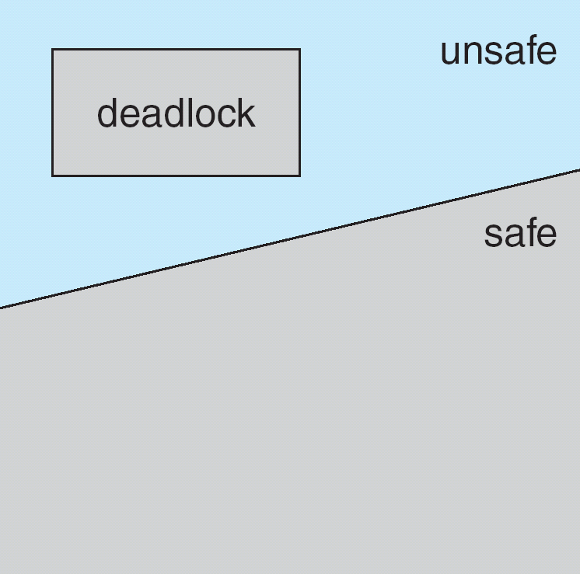
Basic Facts
If a system is in safe state ⇒ no deadlocks
If a system is in unsafe state ⇒ possibility of deadlock
Avoidance ⇒ ensure that a system will never enter an unsafe state.
Safe, Unsafe, Deadlock State

Slide 41
Avoidance algorithms
Single instance of a resource type
Use a resource-allocation graph
Multiple instances of a resource type
Use the banker’s algorithm

Slide 42
If all resources in the system has only one instance, a variant of resource allocation graph can be used for deadlock avoidance
Claim edge P_{i} → R_{j} indicated that process P_{j} may request resource R_{j}; represented by a dashed line
Claim edge converts to request edge when a process requests a resource
Request edge converted to an assignment edge when the resource is allocated to the process
When a resource is released by a process, assignment edge reconverts to a claim edge
Resources must be claimed a priori in the system

Slide 43
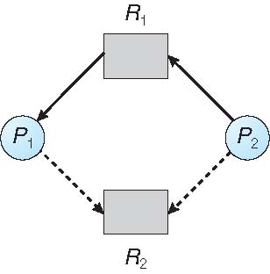
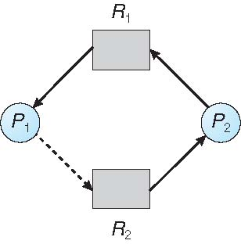
Resource-Allocation Graph
Unsafe State In Resource-Allocation Graph

Slide 44
Resource-Allocation Graph Algorithm
Suppose that process P_{i} requests a resource R_{j}
The request can be granted only if converting the request edge to an assignment edge does not result in the formation of a cycle in the resource allocation graph

Slide 45
Banker’s Algorithm
Multiple instances
Each process must a priori claim maximum use
When a process requests a resource it may have to wait
When a process gets all its resources it must return them in a finite amount of time

Slide 46
Safety Algorithm
A method used to determine if a particular state is safe. It's safe if there exists a sequence of processes such that for all the processes, there’s a way to avoid deadlock:
The algorithm uses these variables:
Need[I] – the remaining resource needs of each process.
Work - Temporary variable – how many of the resource are currently available.
Finish[I] – flag for each process showing we’ve analyzed that process or not.
need <= available + allocated[0] + .. + allocated[I-1] ← Sign of success
Let work and finish be vectors of length m and n respectively.

Slide 47
Data Structures for the Banker’s Algorithm
Let n = number of processes, and m = number of resources types.
Available: Vector of length m. indicates no of available resources of each type. If available [j] = k, there are k instances of resource type R_{j} available
Max: n x m matrix. If Max [i,j] = k, then process P_{i} may request at most k instances of resource type R_{j}
Allocation: n x m matrix. If Allocation[i,j] = k then P_{i} is currently allocated k instances of R_{j}
Need: n x m matrix. If Need[i,j] = k, then P_{i} may need k more instances of R_{j} to complete its task
Need [i,j] = Max[i,j] – Allocation [i,j]

Slide 48
Safety Algorithm
Let Work and Finish be vectors of length m and n, respectively. :
Initialize Work = Available
Finish [i] = false for i = 0, 1, …, n- 1
2. Find an i such that both:
(a) Finish [I ] = false
(b) Need ≤ Work
If no such i exists, go to step 4
Work = Work + Allocation Finish[i] = true go to step 2
if Finish [i] == true for all i, then the system is in a safe state

Slide 49
Resource-Request Algorithm for Process P_{i}
This algorithm determines if request can be safely granted
Let Request = request vector for process P_{i}. If Request_{i} [j] = k then process P_{i} wants k instances of resource type R_{j}
1. If Request_{i} ≤ Need_{i} go to step 2. Otherwise, raise error condition, since process has exceeded its maximum claim
If Request_{i} ≤ Available, go to step 3. Otherwise P_{i} must wait, since resources are not available

Slide 50
Pretend to allocate requested resources to P_{i} by modifying the state as follows:
Available = Available – Request;
Allocation_{i} = Allocation_{i} + Request_{i};
Need_{i} = Need_{i} – Request_{i};
If safe ⇒ the resources are allocated to Pi
If unsafe ⇒ Pi must wait, and the old resource-allocation state is restored

Slide 51
Example of Banker’s Algorithm
5 processes P₀ through P₄; 3 resource types:
A (10 instances), B (5instances), and C (7 instances)
Snapshot at time T₀:
Allocation Max Available
A B C A B C A B C
P₀ 0 1 0 7 5 3 3 3 2
P₁ 2 0 0 3 2 2
P₂ 3 0 2 9 0 2
P₃ 2 1 1 2 2 2
P₄ 0 0 2 4 3 3

Slide 52
Example (Cont.)
The content of the matrix Need is defined to be Max – Allocation
Need
A B C
P₀ 7 4 3
P₁ 1 2 2
P₂ 6 0 0
P₃ 0 1 1
P₄ 4 3 1 The system is in a safe state since the sequence < P₁, P₃, P₄, P₂, P₀> satisfies safety criteria

Slide 53
Example: P₁ Request (1,0,2)
Check that Request ≤ Available (that is, (1,0,2) ≤ (3,3,2) ⇒ true
Allocation Need Available
A B C A B C A B C
P₀ 0 1 0 7 4 3 2 3 0
P₁ 3 0 2 0 2 0
P₂ 3 0 2 6 0 0
P₃ 2 1 1 0 1 1
P₄ 0 0 2 4 3 1
Executing safety algorithm shows that sequence < P₁, P₃, P₄, P₀, P₂> satisfies safety requirement
Can request for (3,3,0) by P₄ be granted?
Can request for (0,2,0) by P₀ be granted?

Slide 54
Deadlock Detection
Allow system to enter deadlock state
Detection algorithm
Recovery scheme

Slide 55
Single Instance of Each Resource Type
Maintain wait-for graph
Nodes are processes
P_{i} → P_{j} if P_{i} is waiting for P_{j}
Periodically invoke an algorithm that searches for a cycle in the graph. If there is a cycle, there exists a deadlock
An algorithm to detect a cycle in a graph requires an order of n² operations, where n is the number of vertices in the graph

Slide 56
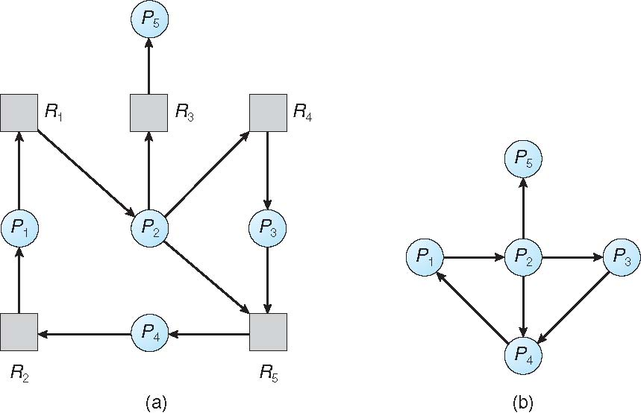
Resource-Allocation Graph and Wait-for Graph
Resource-Allocation Graph
Corresponding wait-for graph

Slide 57
Several Instances of a Resource Type
Available: A vector of length m indicates the number of available resources of each type.
Allocation: An n x m matrix defines the number of resources of each type currently allocated to each process.
Request: An n x m matrix indicates the current request of each process. If Request [i][j] = k, then process P_{i} is requesting k more instances of resource type.R_{j}.

Slide 58
Detection Algorithm
Let Work and Finish be vectors of length m and n, respectively Initialize:
Work = Available
For i = 1,2, …, n, if Allocation_{i} ≠ 0, then Finish[i] = false; otherwise, Finish[i] = true
2. Find an index i such that both:
(a) Finish[i] == false
(b) Request_{i} ≤ Work If no such i exists, go to step 4

Slide 59
Detection Algorithm (Cont.)
3. Work = Work + Allocation_{i} Finish[i] = true go to step 2
4. If Finish[i] == false, for some i, 1 ≤ i ≤ n, then the system is in deadlock state. Moreover, if Finish[i] == false, then P_{i} is deadlocked

Slide 60
Example of Detection Algorithm
Five processes P₀ through P₄; three resource types A (7 instances), B (2 instances), and C (6 instances)
Snapshot at time T₀:
Allocation Request Available
A B C A B C A B C
P₀ 0 1 0 0 0 0 0 0 0
P₁ 2 0 0 2 0 2
P₂ 3 0 3 0 0 0
P₃ 2 1 1 1 0 0
P₄ 0 0 2 0 0 2
Sequence <P₀, P₂, P₃, P₁, P₄> will result in Finish[i] = true for all i

Slide 61
Example (Cont.)
P₂ requests an additional instance of type C
Request
A B C
P₀ 0 0 0
P₁ 2 0 2
P₂ 0 0 1
P₃ 1 0 0
P₄ 0 0 2
State of system?
Can reclaim resources held by process P0, but insufficient resources to fulfill other processes; requests
Deadlock exists, consisting of processes P1, P2, P3, and P4

Slide 62
Detection-Algorithm Usage
When, and how often, to invoke depends on:
How often a deadlock is likely to occur?
How many processes will need to be rolled back?
one for each disjoint cycle
If detection algorithm is invoked arbitrarily, there may be many cycles in the resource graph and so we would not be able to tell which of the many deadlocked processes “caused” the deadlock

Slide 63
Recovery from Deadlock: Process Termination
Abort all deadlocked processes
Abort one process at a time until the deadlock cycle is eliminated In which order should we choose to abort?
Priority of the process
How long process has computed, and how much longer to completion
Resources the process has used
Resources process needs to complete
How many processes will need to be terminated
Is process interactive or batch?

Slide 64
Recovery from Deadlock: Resource Preemption
Selecting a victim – minimize cost
Rollback – return to some safe state, restart process for that state
Starvation – same process may always be picked as victim, include number of rollback in cost factor

